Slide 1

Building Network Telemetry Platform to minimize Security Threats
Siri Varma Vegiraju

Slide 2
Agenda
Why Network Telemetry and its need for a platform
Fundamental pieces in Network Telemetry.
Architecture of a Network Telemetry Platform
Improving Network Security
Conclusion
Extensions to the Platform

Slide 3
Why Network Telemetry ?
Threat detection
Compliance
Anomaly detection

Slide 4
Need for a Platform
A platform isn't just a solution; it's an enabler for endless solutions
Cost Savings
Consistency and Standardization

Slide 5
Components in a Network Telemetry Platform
Collecting data
  Agents running on VMs
  TCPDUMP, WINDUMP
Enrichment
  Metadata
Standardization
  Schemas
  Versioning

Slide 6
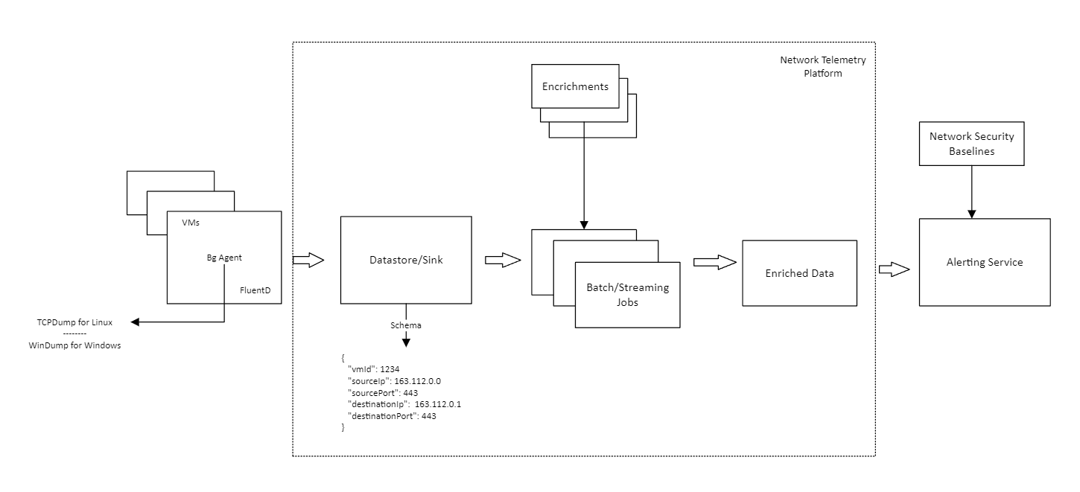
Telemetry Platform Architecture

Slide 7
Improving Network Security
Implement Baselines.
Example of a baseline:
  Database must be accessed using Organization Ips only.
  Communication to VMs must happen on specific ports.
  High risk ports like 22 where SSH Brute force attack can happen are blocked.

Slide 8
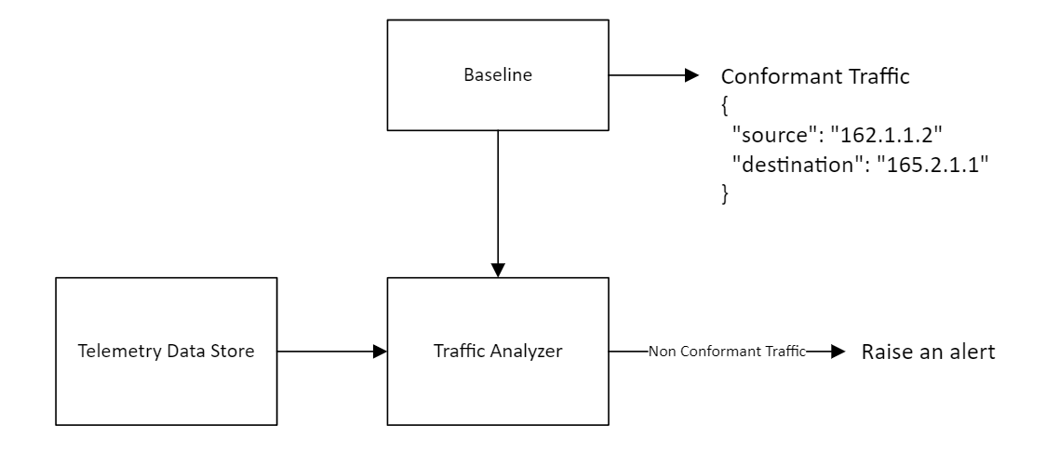
Improving Network Security

Slide 9
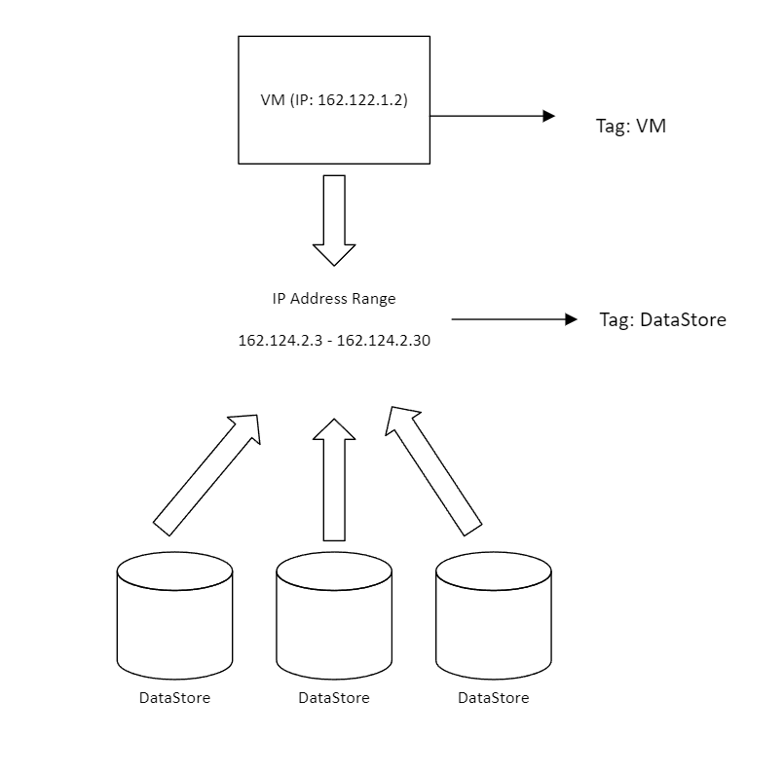
Using Tags for Efficiency

Slide 10
Extensions to the Platform
Security Recommendations
Trends in Network Patterns

Slide 11
Conclusion

Slide 12

Thank you

